Slide 1
More Light, History, Gravity,
Distance, Relativity, and Space-time

Slide 2
Star Color and Temperature
The hotter a star is, the brighter it is.
A star’s color depends on its temperature:
  Hotter temperature = higher energy = shorter wavelength light = blue color and UV.
  Cooler temperature = lower energy = longer wavelength light = red color and IR.
  Our Sun is “medium” temperature, so it looks yellow-orange to us.

Slide 3
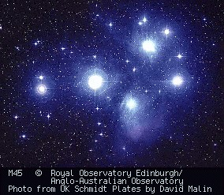
Hot Blue Stars – the Pleiades

Slide 4
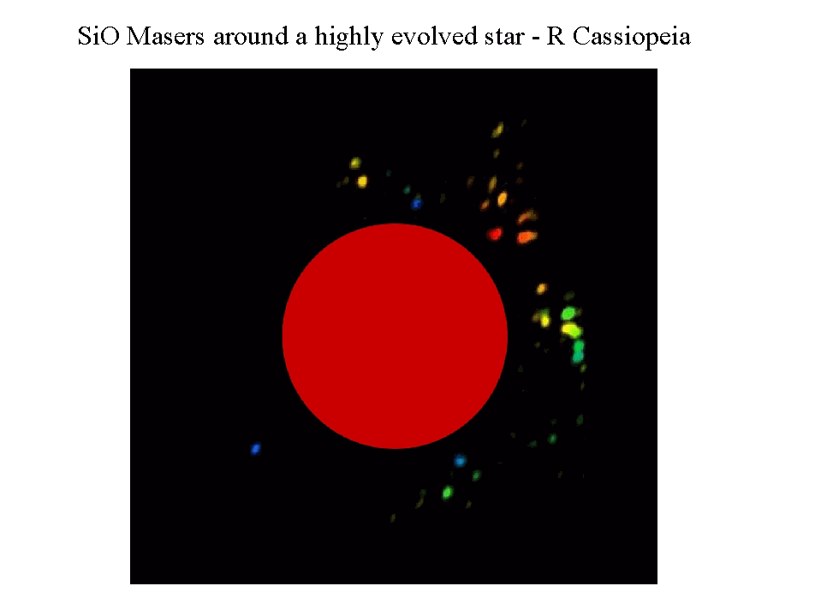
“Cool” Red Giant

Slide 5
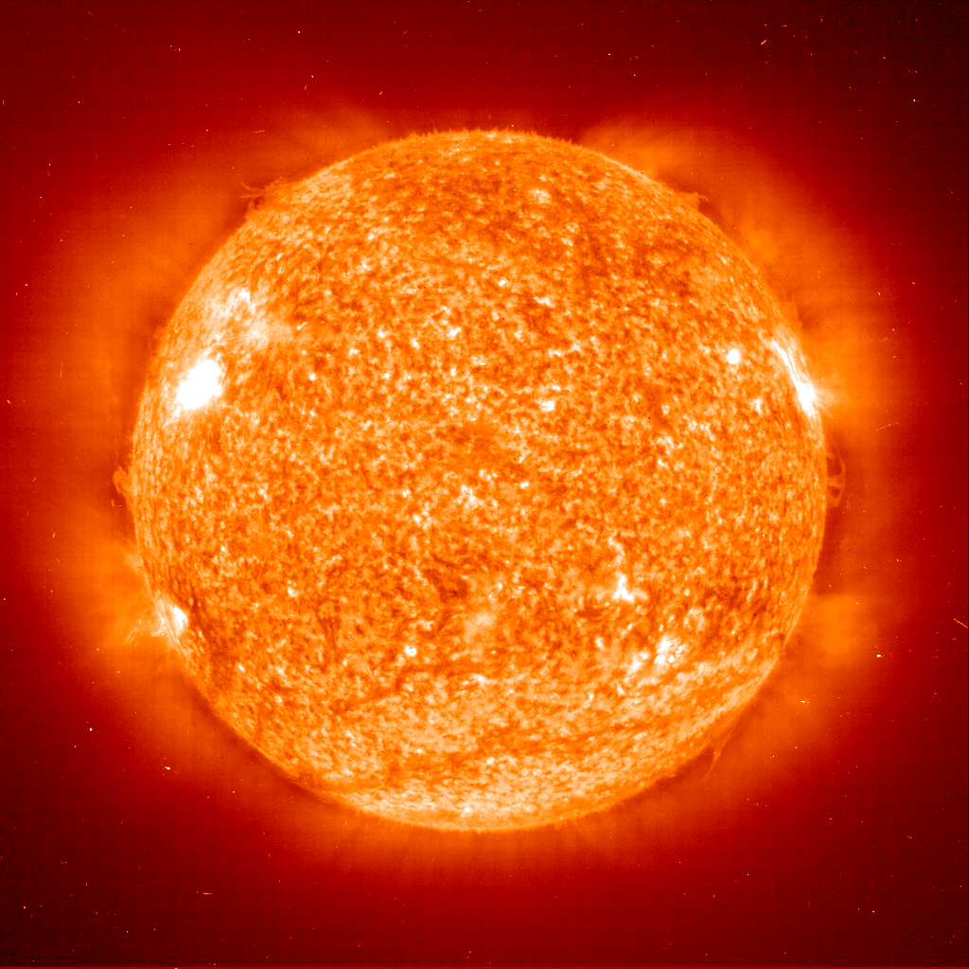
Our Sun

Slide 6
Spectrum and Spectral Lines
Continuous spectrum – star emits light at all wavelengths.
Spectral lines – each chemical element has its own unique set of spectral lines.
Two kinds of spectral lines:
  Absorption lines
  Emission lines
Spectral lines are caused when atoms of gas absorb or emit photons (light particles).

Slide 7



Elements in Stars and Gas Clouds
Determined by using a spectrograph. Each element gives off a characteristic set of lines. See the figure on page 105 of your textbook.
Continuous spectrum
from a star
Absorption lines –
starlight passes
through gas in space
Emission lines –
the same gas against
a cold dark background

Slide 8
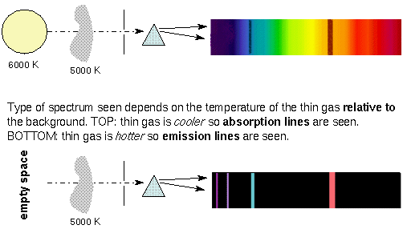
Absorption Lines and Emission Lines

Slide 9
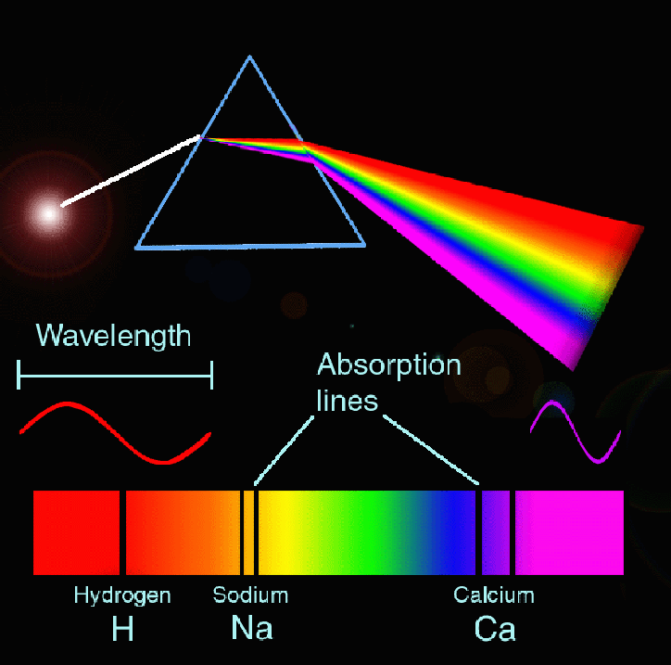
So you are looking out into space with your spectrograph attached to your telescope.
You see this:

Slide 10
What is your analysis?
What elements can you identify?
Where are these elements located?
  In the star itself.
  In the star’s upper atmosphere.
  In a gas cloud that is located directly between you and a star.
  In a gas cloud that has no stars behind it.

Slide 11
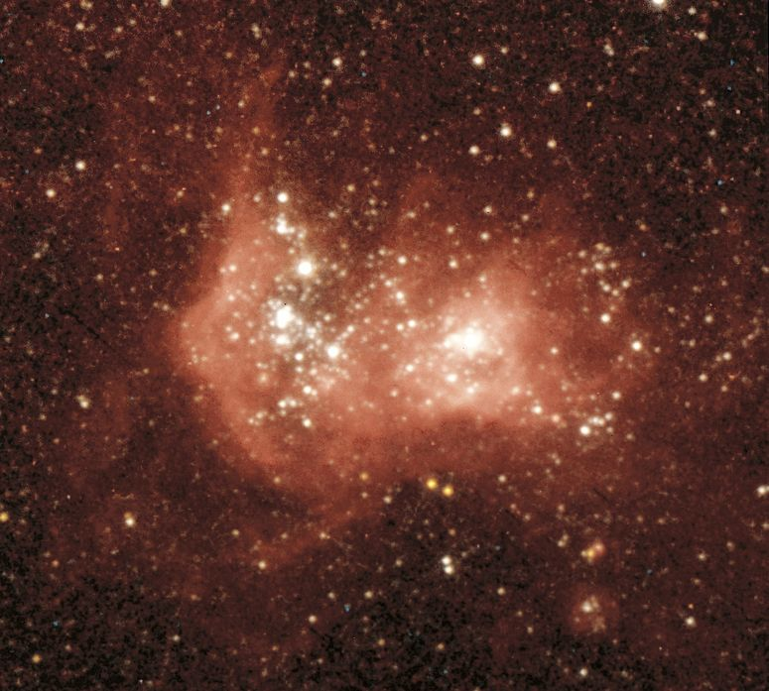
Gas Cloud Emission – Hydrogen
(see text, page 110)

Slide 12
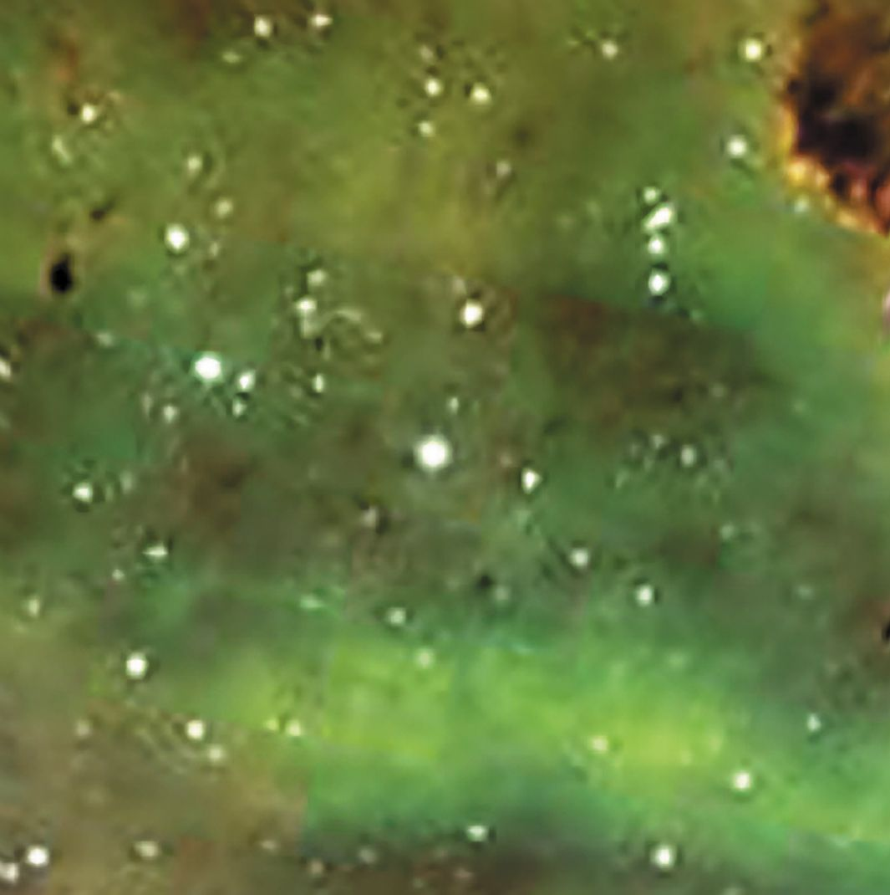
Gas Cloud Emission – Oxygen
(see text, page 110)

Slide 13
Ancient Astronomers
Anaxagoras (600 BC) - calculated the orbit of the Moon and explained lunar eclipses, showed Moon is a sphere.
Aristarchus (300 BC) – heliocentric model (the Sun as the center of the Solar System), calculated size of Earth, Sun and Moon.
Aristotle (300 BC) - chose geocentric model (wrong!) b/c of philosophy, but did show that Earth is round due to shadows it casts on the Moon.

Slide 14
Time Out !
What is heliocentric?
  Means “Sun at the center” of the Solar System.
What is geocentric?
  Means “Earth at the center” of the Solar System.

Slide 15
Ancient Astronomers – Part 2
Hipparchus (200 BC) - classified stars by brightness and calculated the length of a year.
Eratosthenes (200 BC) - measured the size of the Earth using geometry and shadows.
Ptolemy (141 AD) - geocentric model (Earth in the center of the Solar System), explained retrograde motion incorrectly – used epicycles.

Slide 16
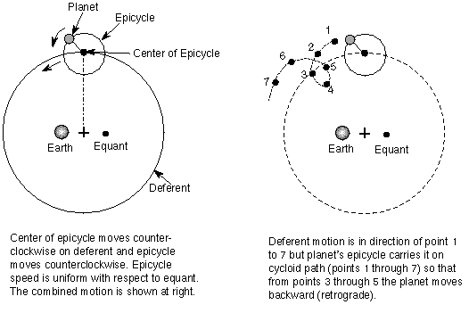
Ptolemy’s Epicycles
Thanks to Alex Cozzini

Slide 17
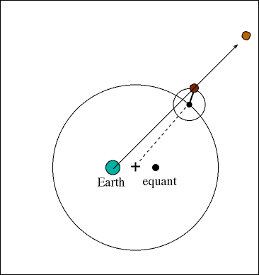
Epicycles – How They Work
Thanks to Alex Cozzini

Slide 18
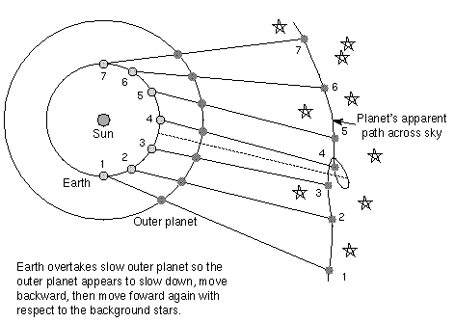
The Right Stuff for Retrograde Motion – Overtaking and Relative Motion
Thanks to Amanda Lipinski

Slide 19
Modern Astronomers
Copernicus (1543) - reintroduced the idea of heliocentrism (correct), but used epicycles like Ptolemy (oops).
Johannes Kepler (1600) - stated three laws of planetary motion, and got it right. Let’s take a look at them.

Slide 20
Kepler
Kepler’s Laws:
  The orbit of each planet is an ellipse with the sun at one focus. Yay for geometry!
  Each planet revolves so that it sweeps over equal areas in equal intervals of time (travels more rapidly when near the Sun). If area 1 equals area 2, then time 1 equals time 2.
ANIMATION
t₂
t₁
a₂
a₁

Slide 21
Kepler continued
  The orbital period of a planet (length of its year in Earth years) is proportional to its distance from the Sun (expressed in Astronomical Units = distance of Earth from the Sun):
  period² = distance³
  For Earth, p = 1 and d = 1.
  Now try this: Mars takes 1.88 Earth years to go around the Sun. How far is Mars from the Sun (in AUs)?

Slide 22
More Modern Astronomers
Galileo (1600) - confirmed heliocentrism.
  One of the first to use a telescope – saw Sun spots that rotated once a month, mapped Moon craters and mountains, found Venus has phases, and found the four largest moons of Jupiter.
  Was tried and convicted by the Inquisition and lived under house arrest, died blind, and was not exonerated until 1992.

Slide 23
More Modern Astronomers
Newton (1700) - explained the forces that produce the motion Kepler defined, and came up with the Law of Universal Gravitation:
  F_{g} = G (m₁ x m₂) / d²
  F_{g} = force of gravity between two objects.
  G = universal constant of gravitation.
  m₁ = mass of object 1.
  m₂ = mass of object 2.
  d = distance between the two objects.

Slide 24
So how does this gravity deal work?
According to Newton’s Law of Universal Gravitation:
  Gravity increases with the size (mass) of an object: bigger object = stronger gravity.
  Gravity decreases with distance between objects (actually as the square of this distance).
  So, if the Earth were twice as far from the Sun as it is, how much less would the Sun’s force of gravity be on the Earth then?

Slide 25
Distance Units for Astronomy
Distances we measure in astronomy are HUGE, so we need some new units. You have already learned the first two:
  Light Year (ly) = distance light travels in one year = 6 trillion miles = 6 million million miles.
  Astronomical Unit (AU) = average distance of the Earth from the Sun = 93 million miles.
  Parsec (pc) = 3.26 light years = about 20 trillion miles. See page 49 in your textbook.

Slide 26
Measuring Distance to
Nearby Stars
We use parallax shift.
We see stars relatively near us from different angles at different times of year.
These stars show a shift in their location compared to their background, and parallax tells us how far away they are.
More parallax shift = star is closer.
Less parallax shift = star is farther away.
Objects very far away show no parallax.

Slide 27
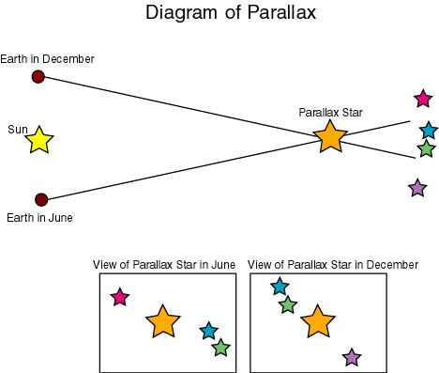
Thanks to Ilyse Zack

Slide 28
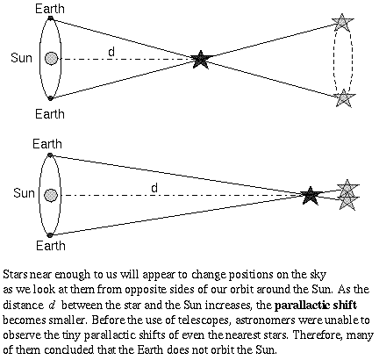
Parallax Again
Thanks to Amanda Lipinski

Slide 29
How About Really Distant Objects?
Remember that objects very far away show no parallax.
So how do we measure distances to the really far out stuff?
We use some other techniques called “The Distance Ladder” – more about that later (includes variable stars and supernovae !).

Slide 30
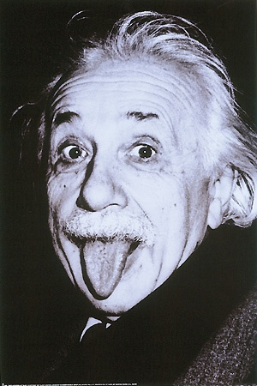
Relativity !!

Slide 31
Relativity
Albert Einstein began a revolution in science by ignoring common sense.
He came up with two theories of what we call relativity:
  Special Relativity (1905) – changed our ideas about space and time.
  General Relativity (1915) – changed how we think about gravity.

Slide 32
Special Relativity – How motion affects our measurements of distance, time, and mass.
You experience physical reality the same way regardless of the (constant) velocity at which you move.
Example: You are inside a train moving at 100 mph and drop your textbook to the floor – say it takes one second to fall. Now you stop the train and try the same thing. How long will it take the book to fall to the floor?

Slide 33
Special Relativity continued
No matter what your speed or direction, you always measure the speed of light to be the same (186,000 miles per second).
Example: You are in a car moving toward a yellow street light at 93,000 miles per second. Your friends are standing under the light. How fast do your friends see the light photons coming at them? How fast do you see the light photons coming at you? What color is the light your friends see? What color is the light you see?

Slide 34
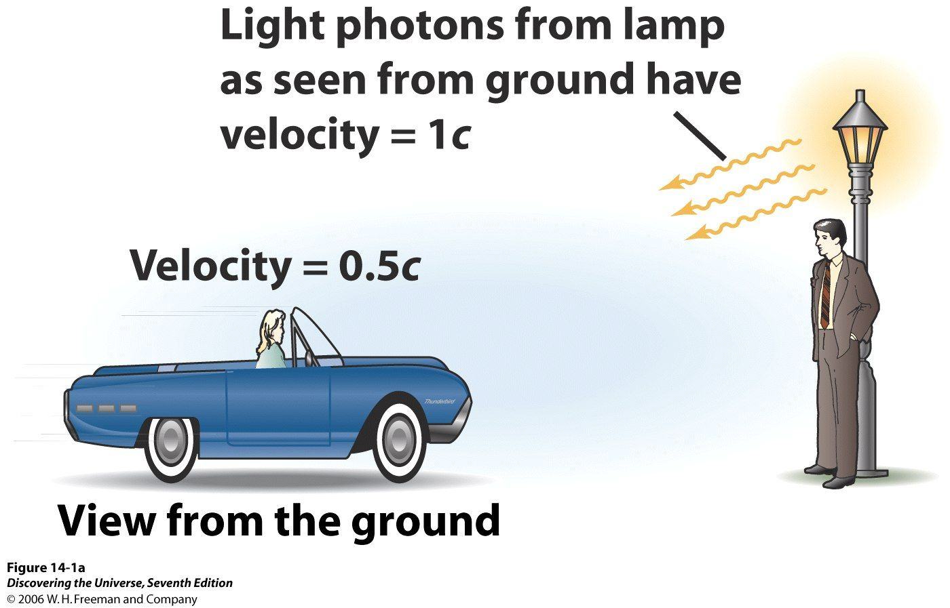

Slide 35
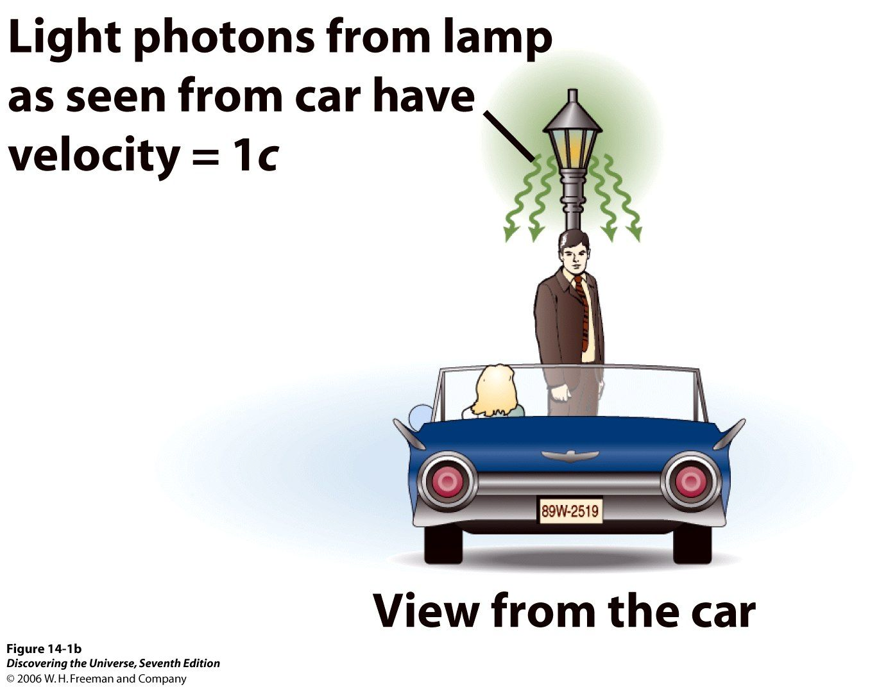

Slide 36
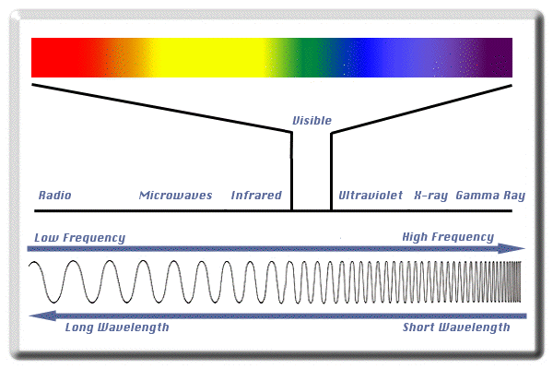
LOW ENERGY HIGH ENERGY

Slide 37
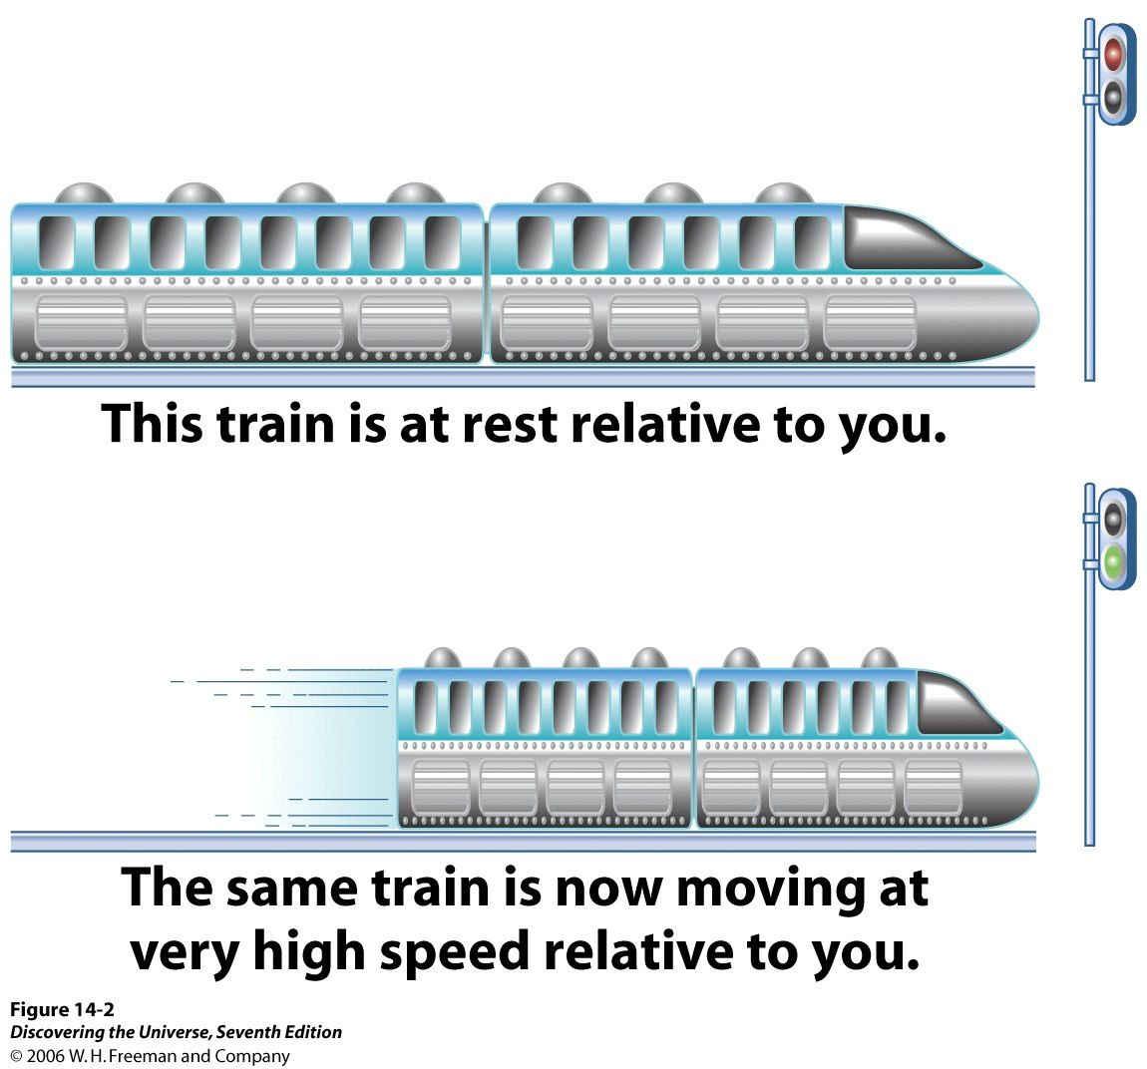
Special Relativity – Weird Results
An object gets shorter as it travels faster.

Slide 38
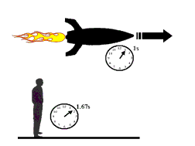
Special Relativity – Weird Results
Moving clocks run more slowly than clocks that are at rest – called time dilation. Requires that space and time be combined into space-time.

Slide 39
Special Relativity – Weird Results
The faster an object moves, the heavier it gets (mass increases). This means nothing can go as fast as light.
Velocity | Mass
3.0 m/s (walking speed) | 50.000000000 kg
300 m/s (about 670 mi/hr) | 50.000000000 kg
3000 m/s (about 6700 mi/hr) | 50.000000002 kg
0.1 c | 50.25 kg
0.5 c | 57.74 kg
0.9 c | 114.7 kg
0.99 c | 354.4 kg
0.999 c | 1118 kg
c | infinite

Slide 40
Special Relativity – Weird Results
Matter and energy are really different forms of the same thing.
E = mc²
  You can change energy into matter, and matter into energy.
  A small amount of matter can give a HUGE amount of energy, like in the Sun and nuclear weapons.

Slide 41
Space-time (Result of
Special Relativity)
Space-time has four dimensions – three space dimensions plus time.
What does a space-time diagram look like?
The following figure is the space-time diagram of the collision and joining together of two black holes. Time (t) is on the vertical axis, and two dimensions of space are shown (p and z).

Slide 42
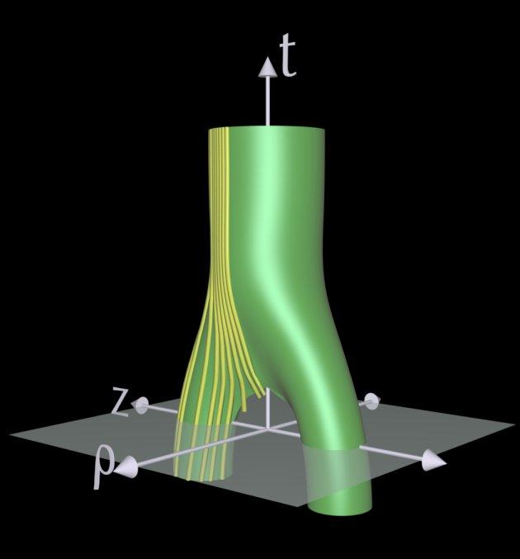

Slide 43
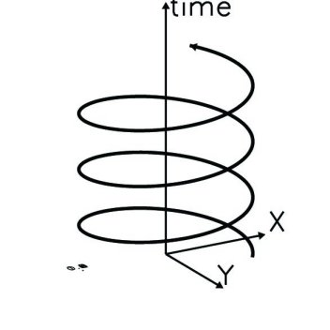
Space-time Diagram and
World Lines
Whose World Line
Is this, anyway ??

Slide 44
General Relativity – How matter curves space-time and creates gravity.
Matter makes space-time curve.
The more matter there is (more mass), the more space-time is distorted or curved.
The curvature of space-time creates the gravitational force between objects.

Slide 45
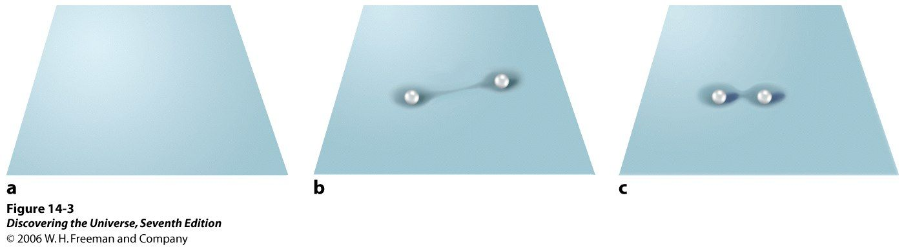
Matter Curves Space-time

Slide 46
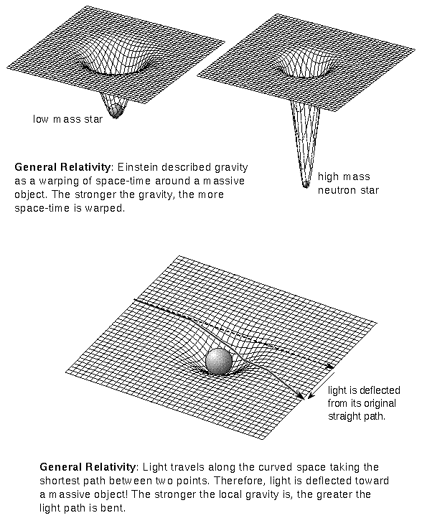
Curved space-time: bigger mass = bigger curve = stronger force of gravity.

Slide 47
Curved Space-time and Orbits
Newton’s equation for gravity says an orbit is always an ellipse.
But Einstein’s space-time gets curved by matter, and orbits look different near a huge mass (like a black hole).
ANIMATION – Orbits in strongly curved space-time.

Slide 48
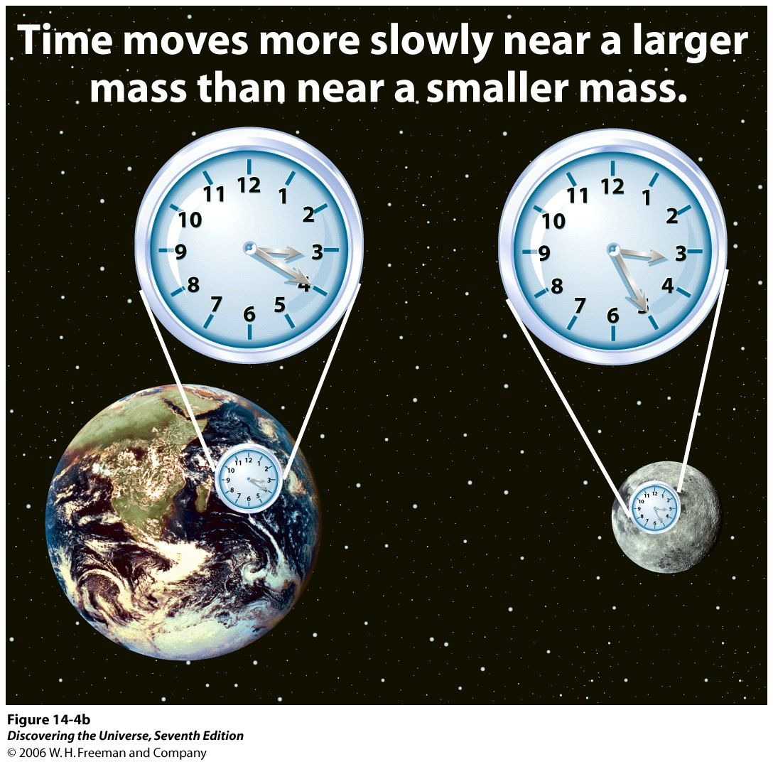
General Relativity – Weird Results
Time slows down in the presence of matter.

Slide 49
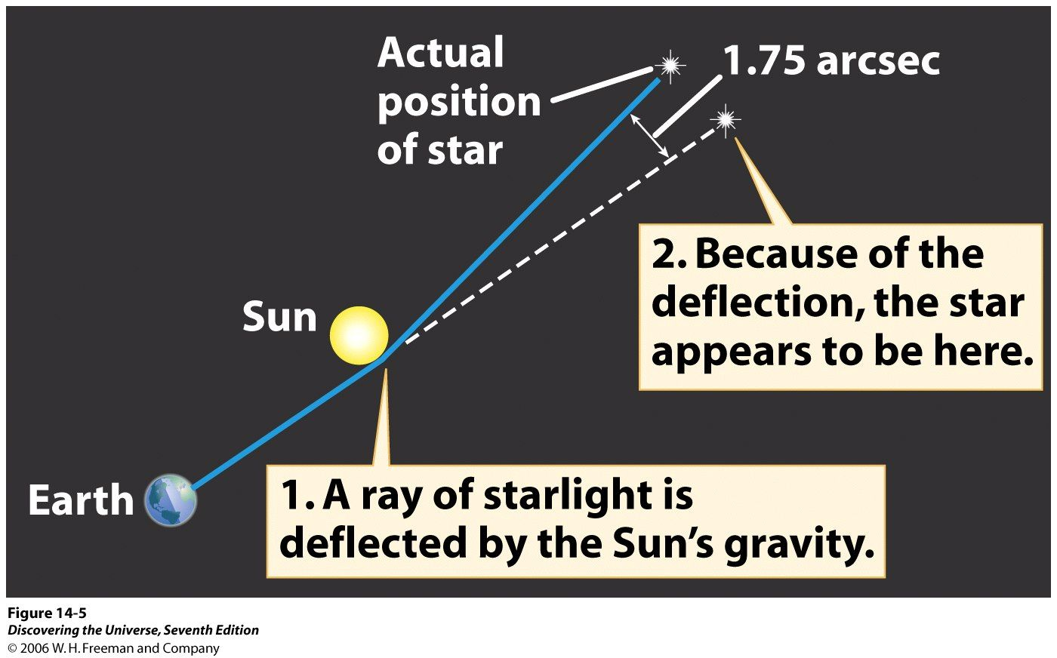
General Relativity – Weird Results
The curvature of space-time (gravity) changes the path of light.

Slide 50
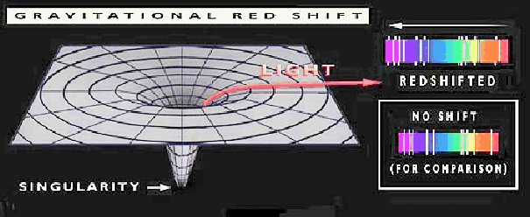
General Relativity – Weird Results
The curvature of space-time (gravity) changes the color (wavelength) of light – called gravitational redshift. A blue light looks red:

